Slide 1
THE DATA SCIENCE CRASH COURSE!
Compiled by Emmanuel Ogunwede

Slide 2
The Roadmap!
Drawing the lines
Supervised and Unsupervised Learning
Types of Supervised Learning
Families of machine learning algorithms
Working with data
All about evaluation
The Machine learning pipeline
Hands-On with the iris dataset!!

Slide 3
Drawing the Line
Artificial Intelligence
it is described as an effort to automate intellectual task. Its is a broad field encompassing both machine learning and deep learning
Machine Learning
It basically describes a field of learning where a machine/computer program learns to perform a task and gets better at the task based on continuous training on data.
Deep Learning
In a layman’s term the concept of deep learning is just about advanced neural networks with special layers that has the ability to preprocess or filter data so as to get deeper understanding of the data before processing an output!
Deep neural networks are networks wit two or more hidden layers!
SUMMARY
ML and DL are subfields in AI and involves the use of mats and statistics in advanced ways to solve problems

Slide 4
Supervised and Unsupervised Learning
Supervised Learning
This can basically be understood as learning through examples or with guidance. In this type of learning the machine learning model is trained with data whose target values are already known, it continues to compare it’s prediction with the actual answer and tries to adjust until error is minimal or zero. After this the model can now be trusted to work on data whose answers are not known.
The objective of this type of learning is to define an objective (loss) function and minimize the loss function (the error in model prediction)
Unsupervised Learning
In unsupervised learning, the model is fed with data without “answer”.
The objective of unsupervised learning is usually to identify common patterns in the data and group the data into different clusters or groups such that data in a group has the same pattern with other data points in the same group.
Further reading
Supervised and unsupervised learning

Slide 5
Types of supervised Learning
Classification
When your goal is to classify your data inputs or records into a finite group e.g. classifying network pattern data as normal or abnormal, it is called classification.
When there are only 2 groups it is called binary classification, when it is 3 or more it is called multiclass classification. When you have to categorize, say, objects according to their color and shape such classification are called “multi-label classification”
Regression
When you have to predict continuous values e.g. the price of houses based on inputs such as their location and size such problems are referred to as regression problems.
The basic difference is that classification target values(value to be predicted) are discrete while regression target values are continuous
Further reading
Classification vs Regression

Slide 6
Families of Machine learning Algorithms
Machine learning algorithms can be categorized to belong to one of the following broad families based on assumptions/approaches they use to solve problems.
Linear models: e.g. logistic regression and support vector machine
Tree based models: e.g. Decision trees, random forest
KNN based models e.g. k-nearest neighbor algorithm
Neural Networks

Slide 7
Working with Data
At the heart of every machine learning model is data. There are various formats this data can come in.
Common formats include:
SQL files
XML
XLS files
CSV files
The most common form data usually comes in is CSV, most files already in an excel spreadsheet form, but data may not always be like that.
Rows are usually referred to as records while columns represent a feature.
A collection of the feature names can be referred to as feature vectors.

Slide 8
Working with Data
It is common for the last column in a supervised learning problem to be the target variable, but sometimes it may be the first, second or any other column. It is therefore wise to first inspect data visually before taking any action.
The features/columns can come in different types(e.g. numeric, categorical, object, datetime)
It is wise to always check to see that our data is encoded in the correct/appropriate type before feeding it to the model. Also note that different data types require different type of preprocessing techniques

Slide 9
Working with Data
One of the most common things to look out for when working with data is to check if your data set is balanced or imbalanced.
A balanced dataset is a dataset where the records are evenly distributed between all classes e.g. if there are two classes and 100 records there should be 50 records in each class(in a perfect situation)
When there is significant difference in the size of the data records in each class then the dataset is said to be imbalanced.

Slide 10
All About Evaluation
We evaluate a model to check it’s performance and determine if we can deploy the model
The nature of our problem and even the nature of the data set affects the way and tools we employ in evaluating our models
Common evaluation metrics include accuracy, precision, recall, confusion matrix etc.
To fully understand model evaluation refer to the following:
Evaluation techniques
choosing the right metric

Slide 11
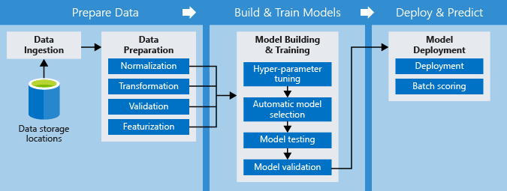
The Machine learning pipeline
A pipeline is a defined process followed to achieve an intended goal. For instance, software projects are usually subject to a pipeline popularly referred to as the software development life cycle. The machine learning pipeline is also a lifecycle for machine learning project, it describes the steps and processes involved in a machine learning project.

Slide 12
The Machine learning pipeline
STEP 1
Step 2
Define project objective
Define the problem being solved
Define the features to be used in the models and their target variables
Prioritize modeling criteria for example is speed of more importance to model accuracy?
Wrangle and explore Data
Locate Data
Collect data
Analyze data
Engineer data to create new features if necessary

Slide 13
The Machine learning pipeline
STEP 3
STEP 4
Build the model
Select features that will be used in the model
Build the model
Validate the model
Interpret and explain the model
Try to understand the model and impact of each feature used on the model
Clearly explain your understanding of the model

Slide 14
The Machine learning pipeline
STEP 5
SUMMARY
Implement and maintain Model
Host model using an API model
Test the API endpoint and what the endpoint returns
Monitor and Maintain the model
To get best performance it is wise to always draw out a pipeline for your ML project before starting.
Your models are only as good as your data! Spend time understanding and exploring your data

